Slide 1
Chapter 13:
Reducing the chance of pregnancy and STIs

Slide 2
13.1 Contraception
Most methods of birth control involve prevention of fertilisation and are known as contraception.
Abstinence
Abstinence is not having sexual intercourse at all. This is the only option that has no risk of either pregnancy or side effects.
Detection of ovulation
Some methods of birth control rely on a female determining the time of ovulation. She can then abstain from sexual intercourse on the days when fertilisation is most likely. This is known as periodic abstinence or the ‘safe period’ technique. These methods are not particularly reliable. They include:
Rhythm method
Temperature method
Mucus method
Symptothermal method

Slide 3

13.1 Contraception
Mechanical barriers
A variety of mechanical barriers can be used to prevent the sperm from reaching the egg, therefore preventing fertilisation.
Condom
A condom is made from very thin latex rubber that is rolled on to the erect penis just before intercourse. A condom is effective in preventing semen from entering the vagina, provided it does not tear or slip off after ejaculation. Condoms have an additional advantage in providing protection against sexually transmitted infections.

Slide 4
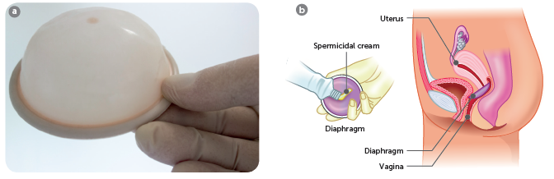
13.1 Contraception
Diaphragm
The diaphragm is a mechanical barrier used by the female. It is a thin rubber cap that fits across the top of the vagina. The correct size must be prescribed by a doctor. It must be inserted before intercourse, and is normally used with a spermicidal cream or jelly to increase effectiveness. It should be left in for at least six hours after intercourse.
a Diaphragm; b Position of a diaphragm

Slide 5
13.1 Contraception
Cervical cap
The cervical cap is similar to, but smaller than, the diaphragm. It fits directly over the cervix. Similar to the diaphragm, the cervical cap must be inserted prior to having intercourse and left in for at least six hours after ejaculation, and should be used with a spermicide.
Female condom
The female condom (the Femidom) is a lubricated polyurethane sheath that lines the vagina. At each end of the sheath is a flexible ring; the one at the closed end fits over the cervix, and the other sits over the folds of skin that surround the entrance to the vagina. The female condom is an effective contraceptive device and gives protection against sexually transmitted infections.

Slide 6
13.1 Contraception
Spermicides
Spermicides work in two ways:
They contain a substance that immobilises and destroys sperm.
They react with moisture in the vagina to form bubbles of carbon dioxide gas, which present a physical barrier to the sperm.
They are available as creams, tablets, pessaries or aerosol foam.
Spermicides may be used with the condom, diaphragm and cervical cap. They are very unreliable when used alone, but they do add to the effectiveness of barrier devices.

Slide 7
13.1 Contraception
Hormonal contraception for women
One of the most effective methods of contraception is to prevent ovulation by changing the hormone levels in the female’s body.
Contraceptive pills
There are two main types of oral contraceptive pill:
Combined pill: contains substances similar to the two female hormones, oestrogen and progesterone. When taken daily for the first 21 days of the menstrual cycle, the substitute hormones prevent the release of mature eggs from the ovary. The cervical mucus also becomes thick and sticky, making it difficult for sperm to travel upwards from the vagina. The ‘hormones’ also alter the lining of the uterus so that it becomes less receptive to the implantation of an embryo.
Mini pill: contains only the progesterone substitute progestogen. This ‘hormone’ makes the cervical mucus thicker so that sperm cannot enter the uterus. It also changes the lining of the uterus, making it difficult for a fertilised egg to implant.

Slide 8
13.1 Contraception
Hormone implants
Implanon NXT is a soft plastic stick about 4 cm long that is inserted beneath the skin on the inner side of the upper arm. It slowly releases progestogen into the body and provides contraception for three years.
The implant can be easily removed, and ovulation usually returns within three weeks.
Vaginal ring
A vaginal ring, marketed in Australia as NuvaRing, is a soft plastic ring placed in the vagina, where it releases low doses of the oestrogen and progesterone. It is left in the vagina for three weeks and taken out for one week. The small amounts of hormones released prevent ovulation, cause the mucus in the cervix to thicken so that sperm cannot enter the uterus, and change the lining of the uterus so that implantation cannot occur.

Slide 9
13.1 Contraception
Hormonal contraception for men
Male hormonal contraceptives are being developed in a number of different forms. One that has been trialled in Australia involved an implant of the hormone testosterone being placed under the skin every four months. This was combined with an injection of progesterone every three months, and was found to be effective in suppressing sperm production. Ongoing research on 1000 men in China is designed to test the drug’s effectiveness, evaluate its safety and monitor side effects.
Other options currently under development include a gel or tablets that also contain testosterone and a synthetic progesterone.

Slide 10
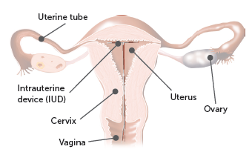
13.1 Contraception
Intrauterine devices
Intrauterine devices, or IUDs, are small devices made of plastic, and often containing copper, that are inserted into the uterus. There are 2 main types.
Hormonal IUD
A hormonal IUD is made up of a plastic frame with a core that slowly releases the progestogen hormone levonorgestrel. It works by releasing its hormone at a steady rate that makes the lining of the uterus, the endometrium, thin and unsuitable for the implantation of a fertilised egg. The hormone also stimulates the cervix to produce thick mucus that prevents sperm from entering the uterus and swimming towards the egg. In some women, the hormone from the IUD stops ovulation altogether.
An IUD in the uterus

Slide 11
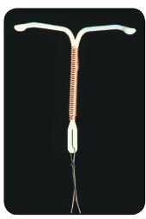
13.1 Contraception
Copper IUD
A copper IUD consists of a plastic frame with copper sleeves or copper wire around it. It works mainly by inhibiting the movement of sperm and thus preventing them from moving through the uterus.
It also causes changes to the endometrium which, if an egg were to be fertilised, would stop the egg from attaching to it. Because of this, copper IUDs are sometimes used as an effective form of emergency contraception up to five days after unprotected sex.

Slide 12
13.1 Contraception
Emergency contraception for women
Sometimes it is necessary to try to prevent pregnancy after sex instead of before. The emergency contraceptive pill is commonly available as a single table of progestogen, and works by preventing or delaying ovulation, preventing sperm from reaching an egg, and preventing implantation of an embryo in the lining of the uterus.
The sooner the pill is taken after unprotected sex, the more effective it will be; effectiveness is much reduced after 72 hours, although it may still prevent pregnancy if taken four or five days after sex.

Slide 13
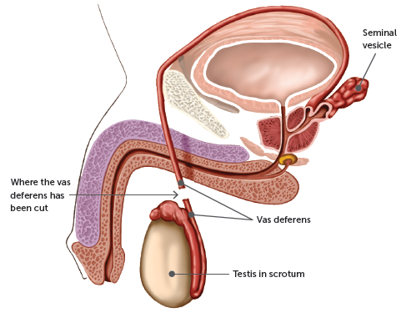
13.1 Contraception
Sterilisation
Sterilisation is a permanent method of birth control for men and women where the anatomy of the reproductive system is altered so that the sperm and egg are unable to meet. While sometimes reversable, it should be thought of as a permanent procedure.
Male sterilisation (vasectomy)
Vasectomy has traditionally involved the removal of a small piece of each vas deferens. The operation is relatively simple: a small cut is made on each side of the scrotum. A small segment is then removed from each vas deferens and the cut ends are tied or sealed with heat. The cuts in the scrotum are then closed.
A non-surgical vasectomy is being tested, which involves injecting a gel into the vas deferens that blocks the path of the sperm.

Slide 14
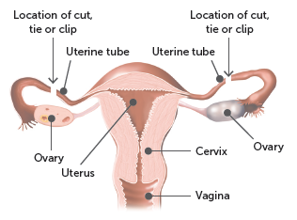
13.1 Contraception
Female sterilisation (tubal ligation)
Tubal ligation is a relatively simple operation performed under general anaesthetic. a small incision is made in the abdomen and the uterine tubes are located. Each tube is then cut, a small piece is removed, and the ends are tied. Alternatively, an instrument called a laparoscope may be used. It is passed into the abdominal cavity through a small cut at the lower edge of the navel. Once it is inside the abdominal cavity, the doctor is able to locate the uterine tubes and fit metal clips to each, crushing that section of the uterine tube. After tubal ligation, sperm cannot reach the egg, and the egg cannot reach the uterus.

Slide 15
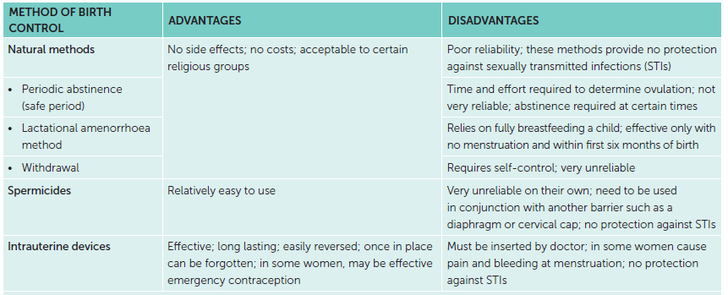
13.1 Contraception
Choice of contraception method
Factors to take into consideration when choosing a method of contraception include the reliability, side effects, convenience, availability, cost, permanence and personal preferences, including religious beliefs.

Slide 16
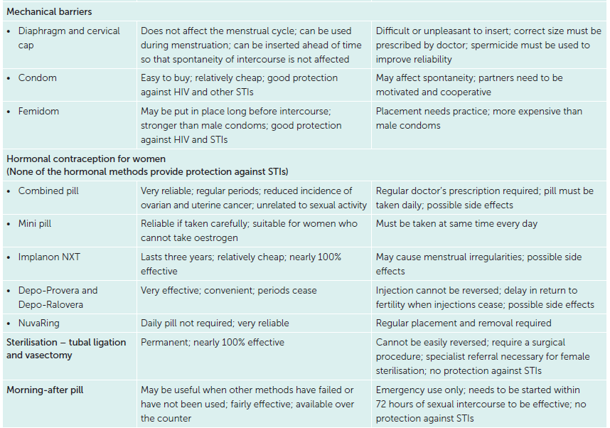
13.1 Contraception

Slide 17
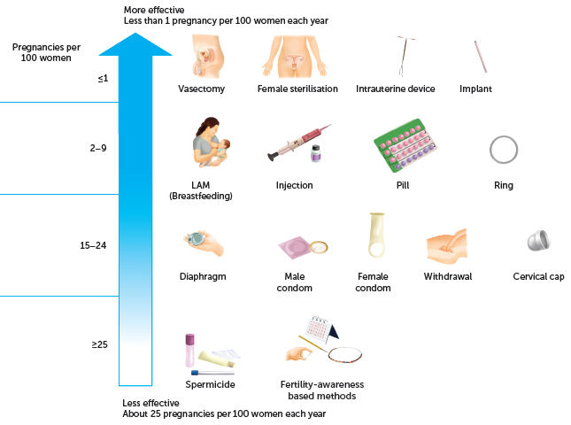
13.1 Contraception
Reliability
Relative effectiveness of birth control procedures

Slide 18
13.2 Sexually transmitted infections
Sexually transmitted infections
Sexually transmitted infections (STIs) are infections that are transmitted by close body contact, usually with the genital organs. They are caused by viruses, bacteria, fungi or parasites that are passed from an infected person to a partner during sexual activity.
Young people are most at risk of contracting an STI. In Australia, three-quarters of known cases of STIs occur in people aged 15 to 29 years. Unlike many other communicable diseases, there is no vaccine readily available for the majority of STIs. Furthermore, for many STIs, one attack does not make a person immune or any less likely to contract the disease if exposed to infection again.

Slide 19
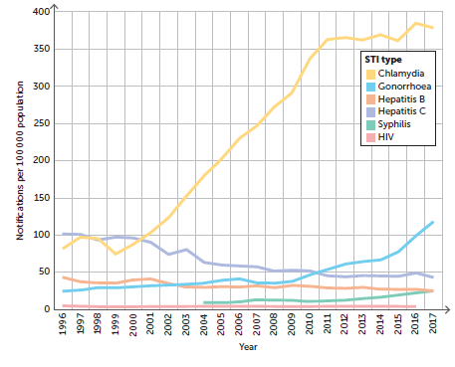
13.2 Sexually transmitted infections
Notification rates of sexually transmissible infections and bloodborne viruses in Australia, 1996–2017

Slide 20
13.2 Sexually transmitted infections
Chlamydia
The most common STI, chlamydia, is caused by a highly specialised bacterium, Chlamydia trachomatis. Often people show no symptoms and are unaware that they are infected with chlamydia. When an infection is diagnosed, it can be treated with antibiotics.
Infection
Chlamydia trachomatis is transmitted by vaginal or anal sex with an infected person. Both men and women may be infected, and it occurs mostly in people aged under 25 years.
Men may develop an infection of the urethra known as nonspecific urethritis (NSU), which has the symptoms of a yellow, mucus-like discharge from the penis and a burning sensation when passing urine. If untreated the bacterium can spread to the epididymis, causing epididymitis (pain and swelling). It can lead to infertility if both testes are infected. However, epididymitis in both testes is very rare.

Slide 21
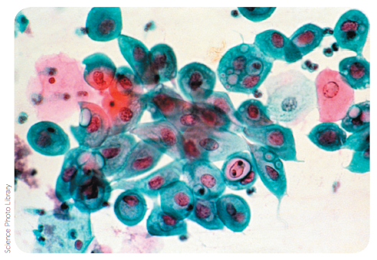
13.2 Sexually transmitted infections
Most infected women have no symptoms. This makes the disease very dangerous, because if untreated it can lead to infertility, eye infection and arthritis. Some women show symptoms of pelvic inflammatory disease (PID), which is inflammation of the organs in the pelvic region such as the uterus and uterine tubes. Continual inflammation of the uterine tubes may lead to blockage by scar tissue, and thus to infertility.
Implantation of an embryo outside the uterus – an ectopic pregnancy – may also occur. If the infected woman is pregnant, there is a 70% chance that the disease will be passed to the foetus during birth. There is also some evidence that chlamydia may cause a significant increase in the risk of having a premature birth or a stillborn child.
Photograph of a cervical smear taken with a light
microscope. Spherical Chlamydia trachomatis cells (dark pink) can be seen inside the epithelial cells of the vagina (light pink and light blue).

Slide 22
13.2 Sexually transmitted infections
Diagnosis and treatment
If a chlamydial infection is suspected, a urine test can be done in males and in females. A more accurate diagnosis can be made with a swab from the vagina, cervix, anus or penis, which is then analysed in a laboratory. If infection by Chlamydia trachomatis is confirmed, the usual treatment is a course of antibiotics, although even with prolonged treatment the bacterium may never be completely eliminated from the body.

Slide 23
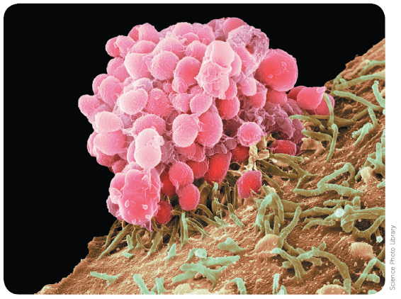
13.2 Sexually transmitted infections
Gonorrhea
Gonorrhoea is an infectious disease that mainly affects the mucous membranes of the excretory and reproductive systems, the rectum, and occasionally the eyes and throat. The disease is caused by a bacterium, Neisseria gonorrhoeae, that is transmitted during sexual intercourse. The disease affects both males and females, and symptoms appear about 2–10 days after infection, although in females these may not be recognised. The period between infection and the appearance of symptoms is called the incubation period of a disease.
SEM of Neisseria gonorrhoeae bacteria (pink) infecting a cell (brown)

Slide 24
13.2 Sexually transmitted infections
Infection
In males, the bacterium enters the urethra during intercourse with an infected partner. After the incubation period, inflammation in the urethra results in a burning feeling in the penis and extreme pain when passing urine. Later, there is a yellow discharge of pus from the penis. If untreated, the urethra may become permanently constricted, resulting in difficulty in urinating. If untreated, the infection can spread to other organs of the body, such as to the testes, causing eventual sterility; to the joints, causing a type of arthritis; or to the heart or eyes.
In females, the disease is sometimes considered more serious, as there may be no early symptoms, or the symptoms may go unrecognised in more than 70% of infected women. Bacteria enter the vagina during intercourse with an infected male. In most cases, the urethra or cervix are infected. A woman may have the disease for months before pain causes her to seek medical treatment. Untreated, the infection spreads to the oviducts and to the abdominal membranes. Oviduct infection may cause permanent blockage and thus infertility.

Slide 25
13.2 Sexually transmitted infections
Treatment
Antibiotics are used in the treatment of gonorrhoea and normally result in an easy and effective cure, provided treatment is begun early enough. However, strains of gonococcus that are resistant to antibiotics have evolved and in some cases are becoming increasingly difficult to cure.

Slide 26
13.2 Sexually transmitted infections
Syphilis
Syphilis is caused by a thin, flexible, spiral-shaped bacterium, Treponema pallidum. The disease is normally contracted by direct sexual contact and affects men and women in the same way.
The course of syphilis follows four stages if it is untreated:
Primary stage: syphilis bacterium enters through any small break in the skin during sexual activity with an infected person, then multiplies and spreads through the whole body during an incubation period ranging from 10 days to 10 weeks. The first symptom is one or more small sores, known as chancres. These usually appear on the sex organs but may occur elsewhere on the skin such as lip, finger or eyelid.
Secondary stage: usually follows a few weeks after the primary stage, but may be delayed for up to 12 months. Possible symptoms include skin rashes, sore or ulcerated mouth or throat, mild fevers, and disorders of the bones or eyes. The patient is highly infectious during this stage, which lasts for about 2 years.

Slide 27
13.2 Sexually transmitted infections
Latent stage: begins when symptoms from the primary and secondary stages go away. The latent stage has no noticeable symptoms, but the body is still infected. It may last for many years, and in some cases for the rest of the person’s life. During this stage the infection cannot be passed on to others. However, sometimes the symptoms of the secondary stage return. If this happens, the infection can then be passed to others while the symptoms persist.
Tertiary stage: even without treatment, only a minority of people infected with syphilis develop the complications associated with the tertiary stage, or late stage. However, when symptoms do appear again the results may be devastating: syphilitic heart disease, insanity, blindness, weakening of the blood vessels, physical incapacity, and many other serious afflictions. This can occur anywhere between 5−40 years after the initial infection.
Antibiotics are the usual treatment for all stages of syphilis, and during the primary stage, cure is relatively easy. Surgery becomes necessary in the later stages.

Slide 28
13.2 Sexually transmitted infections
Genital herpes
Genital herpes is a common STI caused by the Herpes simplex virus. There are two forms of the virus.
Herpes simplex type 1 (HSV1) usually produces ‘cold sores’ on the lips but can also affect the genitals.
Herpes simplex type 2 (HSV2) produces blisters on the genital organs.
Both types of the virus are transmitted by skin-to-skin contact and can therefore be passed on during genital, oral or anal sex.
Blisters develop in areas such as the penis of males, and the labia and vagina of females. There may also be accompanying flu-like symptoms or a rash. The blisters break, forming ulcers that then develop scabs. Healing occurs over a period of one or two weeks. Although healing has occurred, some of the virus passes into the nervous system, where it remains for life. The virus can then reinfect the skin or mucous membranes of the genital organs at any time, and the blisters can recur for the rest of the person’s life.

Slide 29
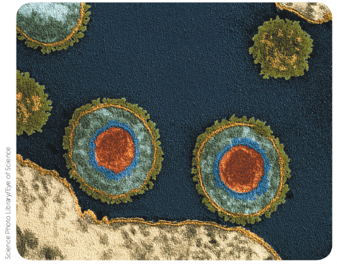
13.2 Sexually transmitted infections
Treatment
There is no way of removing the herpes virus from the body once infected. The treatment for genital herpes includes medication to reduce the pain, saline dressings to clean up the blisters, and sexual abstinence for the duration of the eruption. Antiviral drugs specific to herpes can be prescribed. They do not cure the disease but act to reduce the severity and length of an attack.
TEM of the herpes simplex virus. The orange core is the viral DNA

Slide 30
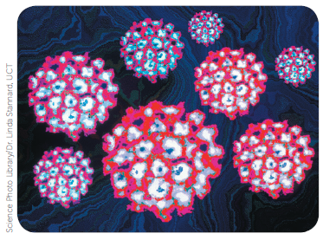
13.2 Sexually transmitted infections
Genital warts
Genital warts are usually found on the genital area – the vagina, labia, cervix or penis – but may occasionally be found around the anus or in the throat. They may be flat, raised or cauliflower-like growths. The warts are caused by a virus, the human papillomavirus (HPV). More than 100 types of HPV have been identified and only a few of these cause genital warts. Some other types of HPV cause ordinary skin warts that can also occur on the genitals, but in such cases sexual transmission is not likely to be the cause.
Genital warts are passed on by a sexual partner infected by the virus. As the warts may be inside the vagina or penis where they cannot be seen, there is a risk of being infected by a person who is unaware of the infection.
HPV virus

Slide 31
13.2 Sexually transmitted infections
Human immunodeficiency virus (HIV)
HIV is known to cause AIDS, or acquired immune deficiency syndrome. Infection with HIV weakens the body’s immune system, and so the infected person is susceptible to infection by other micro-organisms and to some forms of cancer. Almost all cases of HIV infection eventually result in AIDS.
Acquired means that the condition is not inherited, and syndrome refers to a set of symptoms or illnesses that occur as a result of one cause – in this case, an infection by HIV.

Slide 32
13.2 Sexually transmitted infections
Infection
HIV infections go through a number of stages:
Acute infection. When a person is first infected with HIV, the virus replicates rapidly and the level of HIV in the blood is high. During this time, an infected person may suffer flu-like symptoms. The immune response overcomes the infection at this stage and the patient recovers. This stage lasts two to three weeks.
Chronic infection. The second stage is asymptomatic, where the person appears fit and well. The virus continues to multiply, but at a low rate. This stage may last 10 years or longer.
AIDS. A person develops AIDS when the immune system has been damaged to the degree that it is no longer able to resist other infections. At this stage, the person has a high viral load and a low level of helper T-lymphocytes.

Slide 33
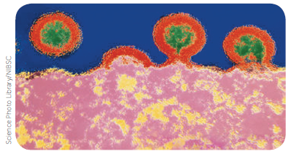
13.2 Sexually transmitted infections
Spread of HIV
HIV is transferred when body fluid from one person enters the bloodstream or comes in contact with the mucous membranes of another. The body fluids that are able to carry enough HIV to be infectious are blood, seminal fluid, vaginal and cervical fluids, and breast milk. These fluids may be spread by:
unprotected sexual intercourse with an infected person
sharing of needles and syringes with an infected person
an infected mother to her child during pregnancy, childbirth or breastfeeding
blood transfusions in countries where blood is not carefully tested
implements that pierce the skin if they have not been sterilised – for example, equipment used for piercing, tattooing, or medical procedures.
TEM showing HIV budding from an infected T-cell. The T-cell (pink) is at the bottom and four viruses can be seen in different stages of budding. Each virus has a protein coat (red) surrounding a core of RNA (green).

Slide 34
13.2 Sexually transmitted infections
Diagnosis
If a person thinks they may have been infected with HIV, a treatment called post-exposure prophylaxis (PEP) can be given. A course of drugs must be taken for a month and must be started within three days of the possible exposure to HIV. The drugs prevent the replication of the virus so that it does not become established in the body. It is not 100% effective.
Infection with HIV can be diagnosed by tests that detect the presence of an HIV antibody in the blood. Depending on the individual, it takes 2−12 weeks for the antibodies to build up to the point where they can be detected.
In Australia, other tests for HIV are also available that measure viral load. 'Viral load' is the term used to describe the amount of HIV in the blood and gives an indication of the activity of the virus.

Slide 35
13.2 Sexually transmitted infections
Treatment
There is currently no cure for HIV infection or a vaccine to prevent infection. There are a number of antiretroviral drugs that inhibit the reproductive cycle of the virus. These drugs are divided into different classes, depending on which stage of the viral life cycle they affect. Patients are usually given a combination of many drug classes.
These combination therapies have resulted in slowing the replication of HIV and suppressing the progression of the disease for some people. In certain cases, they reduce the viral load to levels that cannot be detected. However, the virus still remains in the body in such tissues as the spleen and lymph nodes. Therefore, therapy must be continued indefinitely.

Slide 36
13.2 Sexually transmitted infections
Control of sexually transmitted infections
Preventing STIs
Practising safe sex reduces the transfer of STIs significantly. Safe sex involves taking precautions to make sure that your partner’s semen, vaginal fluids or blood do not enter your body and that your fluids do not enter your partner’s body.
For vaginal or anal intercourse, safe sex involves the use of a condom. This prevents exchange of body fluids and has the added advantage that it prevents pregnancy. For oral sex, condoms or dental dams can be used. A dental dam is a square of very thin latex that can be used as a barrier during oral sex.
Additionally, any parts of the body that may be infectious, such as warts or herpes sores, should be covered and contact with those parts avoided.

Slide 37
13.2 Sexually transmitted infections
Treatment and contact tracing
There are special clinics for the treatment of STIs in most of the major cities in Australia, and free treatment is also available in all public hospitals. Treatment is strictly confidential. In addition to treatment, an important part of the work of STI clinics is contact tracing. By tracing the sexual contacts of patients, the clinics aim to locate and treat people who unknowingly have these diseases. In this way, the spread of the disease can be limited.
Another important role of STI clinics is education. If people know the dangers, and are aware of the symptoms, they are more likely to seek treatment early, when the disease is more easily cured and before they pass it on to others.

